Slide 1
Data analytics

Slide 2
Normalization
Second Normal Form (2NF)
Third Normal Form (3NF)
Boyce-Codd Normal Form (BCNF) or 3.5
First Normal Form (1NF)

Slide 3
Data Model Schema:
DBMS Example: The schema for a university database in a DBMS might define tables like 'Students', 'Courses', 'Professors', and 'Departments'. It outlines the structure of these tables without strictly adhering to a specific model, allowing flexibility in defining relationships and constraints.

Slide 4
Conceptual Modeling:
DBMS Example: Conceptual modeling in a DBMS for a university might involve identifying entities like 'Student', 'Course', 'Professor', and 'Department' without detailing how they are related or structured in the database.
RDBMS Example: Similarly, in an RDBMS, conceptual modeling might define entities such as 'Student', 'Course', 'Professor', and 'Department' and their relationships (e.g., students enroll in courses, professors teach courses) without specifying the exact table structures.

Slide 5
. Logical Modeling:
DBMS Example: Logical modeling in a DBMS could involve creating an entity-relationship diagram that depicts how 'Students', 'Courses', 'Professors', and 'Departments' are related and their attributes.
RDBMS Example: In an RDBMS, logical modeling would involve creating a logical schema, defining tables with specific attributes (e.g., 'Students' table with columns: student ID, name, etc.) and relationships (e.g., foreign keys to link students to courses).

Slide 6
Physical Modeling:
DBMS Example: Physical modeling in a DBMS might involve implementing the university database on a specific DBMS platform, considering file structures, data types, and storage optimization, without strict adherence to relational principles.
RDBMS Example: In an RDBMS, physical modeling would focus on implementing the logical schema on the RDBMS platform, defining table structures, specifying indexes, partitioning data, and optimizing storage based on the relational model.

Slide 7
Identifying Dimensions:
Dimensions are the descriptive attributes of the business context. They provide the context for measurements (facts). Identification of dimensions involves recognizing the various categories or perspectives along which data can be analyzed. For instance, in a sales database, dimensions might include time, product, location, and customer.

Slide 8
Facts and Fact Tables:
Facts are numerical data or metrics that represent business measures or events, while a fact table stores these measurements. They contain foreign keys that link to the related dimension tables. For instance, in a sales scenario, the quantity sold, revenue generated, or discounts applied are considered facts. The fact table holds these measures along with keys referencing dimensions like time, product, and customer.

Slide 9
Segregating:
Segregating involves organizing data into separate tables based on their context or theme. It helps maintain a clear structure and reduces the chances of data duplication. Dimensions and fact tables are segregated to store descriptive information separately from the numerical measures, allowing for more efficient data retrieval and management.

Slide 10
Entity
Strong entity (does not depend on other entity) (Employee id)
Weak entity (depend on other entity)
https://www.geeksforgeeks.org/introduction-of-er-model/

Slide 11
Entity relationship diagram
Terminologies in relation to the ER Model:
a. Entity. (car)
b. Attributes: (car--- supercar, colors, model)
• Composite vs Simple Attributes (ca)
• Single-valued vs Multivalued Attributes
• Derived vs Stored Attributes
c. Complex Attributes.
d. Null values.
e. Entity Type, Entity Set.
f. Key Attribute.

Slide 12
Composite vs Simple Attributes
Composite-- (can be divided into further parts) (date----- year, month, day)
Simple attributes (cannot be divided further) (weight)
Single-valued vs Multivalued Attributes (age),, (job types)
• Derived vs Stored Attributes
(age can be derived from date of birth)
(graduation date of student)

Slide 13
Complex attribute
Combination of multivalued and composite attributes
{Medical condition-----(chronic pain, mental health disorder)}

Slide 14
Entity set
Collection of entities that have same attributes.
Entity set- all the employee range from 20k to 30k.
Employee | name | salary

Slide 15
Key attributes
Roll no

Slide 16
Relationships
One to one (A person has only one unique social security number, and each social security number belongs to only one individual. )
One to Many (
An author writes many books, but each book is authored by only one writer.
Many to one(
Many students study in one university. )
Many to many (Students can enroll in multiple classes, and each class can have multiple enrolled students)

Slide 17
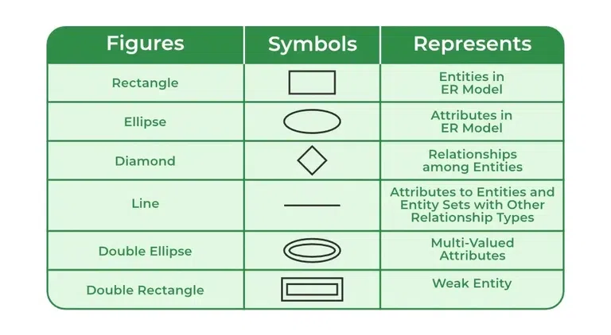
ER diagram

Slide 18
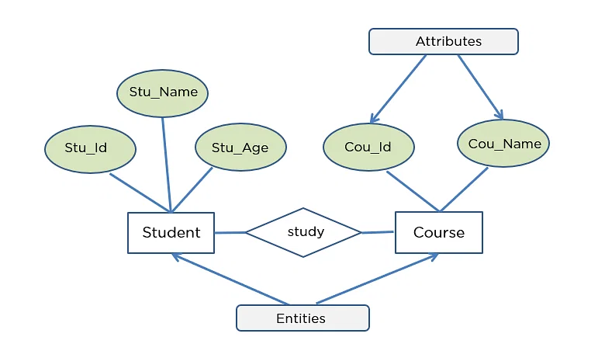

Slide 19
Chat gpt tricks

Slide 20
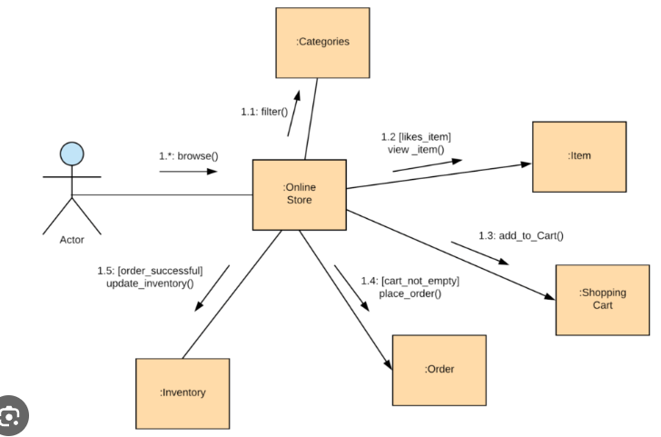
UML diagram
UML, which stands for Unified Modeling Language, is a way to visually represent the architecture, design, and implementation of complex software systems.

Slide 21
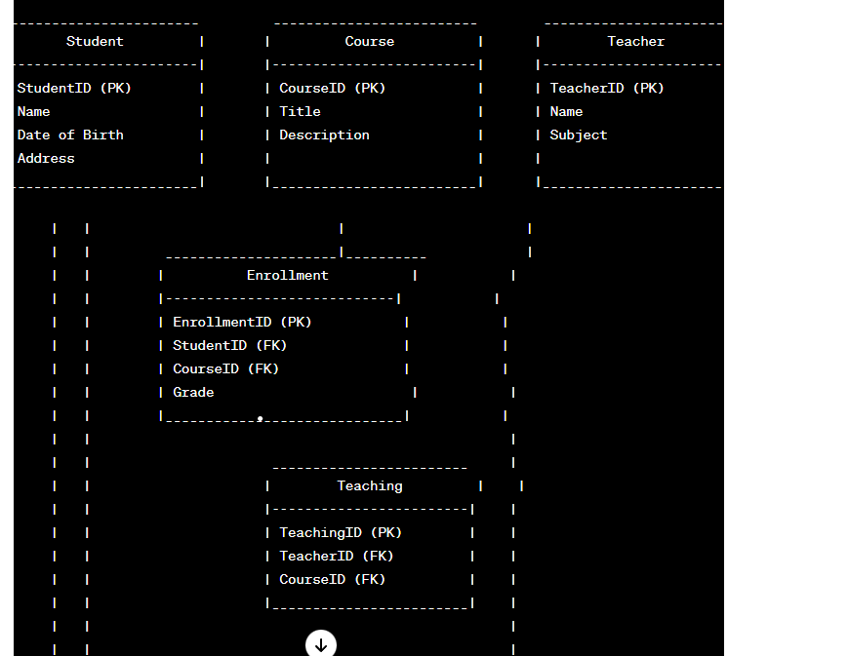

Slide 22
Labs
CREATE DATABASE my_database;
USE my_database;
CREATE TABLE users (
id INT AUTO_INCREMENT PRIMARY KEY,
username VARCHAR(50) NOT NULL,
email VARCHAR(100) NOT NULL,
created_at TIMESTAMP DEFAULT CURRENT_TIMESTAMP
);

Slide 23
INSERT INTO users (username, email) VALUES ('john_doe', 'john@example.com');
SELECT * FROM users;
UPDATE users SET email = 'john_new@example.com' WHERE username = 'john_doe';
DELETE FROM users WHERE username = 'john_doe';

Slide 24
Constraint
-- Creating a database
CREATE DATABASE CompanyDB;
USE CompanyDB;
-- Creating a table with constraints
CREATE TABLE employees (
employee_id INT PRIMARY KEY,
first_name VARCHAR(50) NOT NULL,
last_name VARCHAR(50) NOT NULL,
email VARCHAR(100) UNIQUE,
department_id INT,
salary DECIMAL(10, 2),
hire_date DATE,
CONSTRAINT fk_department FOREIGN KEY (department_id) REFERENCES departments(department_id),
CONSTRAINT chk_salary CHECK (salary > 0)
);

Slide 25
For the labs
SELECT column1, column2 FROM table_name;
SELECT * FROM products WHERE price BETWEEN 10 AND 50;
SELECT * FROM customers LIMIT 10;
DESCRIBE table_name;
SELECT * FROM employees WHERE department = 'Sales';
SELECT department, COUNT(*) FROM employees GROUP BY department;
SELECT department, COUNT(*) FROM employees GROUP BY department HAVING COUNT(*) > 5;

Slide 26
INSERT INTO employees (name, age, department) VALUES ('John Doe', 30, 'IT');
SELECT * FROM customers ORDER BY last_name ASC;
SELECT DISTINCT department FROM employees;
SELECT * FROM products WHERE product_name LIKE 'Apple%';

Slide 27
1. Inner Join:
SELECT employees.employee_id, employees.first_name, departments.department_name
FROM employees
INNER JOIN departments ON employees.department_id = departments.department_id;

Slide 28
2. Full Outer Join:
SELECT employees.employee_id, employees.first_name, departments.department_name
FROM employees
FULL OUTER JOIN departments ON employees.department_id = departments.department_id;

Slide 29
3. Left Join or Left Outer Join:
SELECT employees.employee_id, employees.first_name, departments.department_name
FROM employees
LEFT JOIN departments ON employees.department_id = departments.department_id;

Slide 30
4. Right Join or Right Outer Join:
SELECT employees.employee_id, employees.first_name, departments.department_name
FROM employees
RIGHT JOIN departments ON employees.department_id = departments.department_id;

Slide 31
Cross join
SELECT employees.employee_id, employees.first_name, departments.department_name
FROM employees
CROSS JOIN departments;

Slide 32
6. Multiple Joins:
SELECT e.employee_id, e.first_name, d.department_name, p.project_name
FROM employees e
INNER JOIN departments d ON e.department_id = d.department_id
INNER JOIN projects p ON e.employee_id = p.employee_id;

Slide 33
SELF join
CREATE TABLE employees (
employee_id INT PRIMARY KEY,
employee_name VARCHAR(50),
manager_id INT
);
SELECT e.employee_name AS employee, m.employee_name AS manager
FROM employees e
LEFT JOIN employees m ON e.manager_id = m.employee_id;

